Slide 1
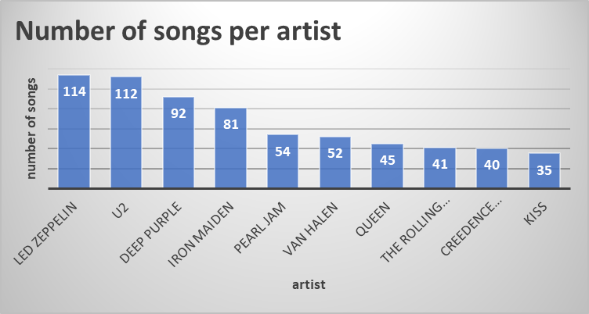
Who is writing the rock music ?
<visualization>
‘Led Zeppelin’ is the top artist who has written the most rock music with 114 songs

Slide 2
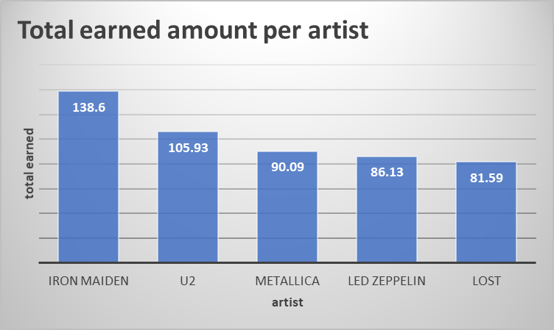
Which artist has earned the most ?
<visualization>
‘Iron Maiden’ is the top artist who earned the most with amount earned 138.6

Slide 3
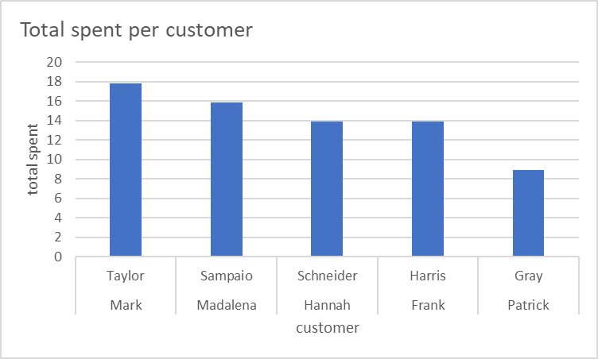
Which customer has spent the most for artist who earned the most ?
<visualization>
Customer 55 , Mark Taylor is the top purchaser with 17.82 for the top artist ‘ Iron Maiden’

Slide 4
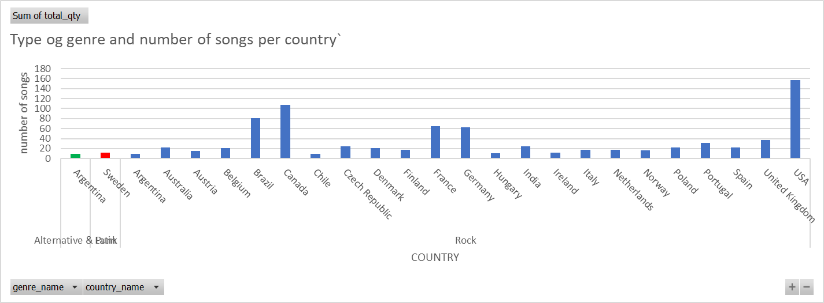
What is the most popular genre in each country
<visualization>
‘Rock’ is the most popular music genre in all countries in our database (blue bars) except in sweden where Latin music is the most popular one (red bar)
N.B In argentina ‘Rock’ and ‘alternative & punk’ (green bar ) have the same popularity according to amount of purchases.

